Slide 1
Managing Your Rock & Mineral Collection
Or any other collection you may have!
In this presentation, the term rocks means anything that would hurt if you were hit by it!!
Created by Wayne Dodd

Slide 2
Cataloguing Basics
The purpose of a catalog is to centralize the management of your collection.
Documentation Methods:
Card File
Spreadsheet
Hand Written Listing
Other

Slide 3
Cataloguing, Cont’d
Wayne's Catalog
Structure of my catalog
Catalog is broken down by Material Type
Minerals
Rocks
Geodes
Meteorites
Fossils
Etc.
Each Type has 3 or 4 tabs of information
Specimen Detail: All the info I have on a specimen. In mine it is alphabetical
Basics: Where the specimen is located, Location of pictures on the Pictures Tab
Technical Data: Chemical Class, Hardness, Specific Gravity, etc.
Photos

Slide 4
Cataloguing, Cont’d
Additional Tabs
Specimen Numbers: A listing of just the number and specimen name
This is mostly used to add and track new items to the catalog
Location Storage key: A graphical representation of all of the places where specimens can be stored. Each has a name. Critical in finding specimens.
Storage Flats: Boxes where non-displayed specimens are stored. Each has its own number and listing of its contents
Specimens in catalog number order

Slide 5
Cataloguing: Numbering and Labeling
Define your numbering scheme
Number of digits in catalog number
Prefix for different types
Rocks begin with an R (R00245)
Geodes begin with a G (G00133)
Minerals: I have no prefix for minerals as the vast majority of my collection is minerals
When you have more than one specimen from the same location, you could add an “Example” designation. i.e.., 00525a, 00525b, etc.
If it has two parts (ie a geode) then number both halves. 00525A1, 00525A2. Another from the same location, 00525B1, 00525B2
Labeling: Many options
Paint a small spot of White Out. Use fine sharpy to write the catalog number
Buy some form of sticky label (rectangle, spot, etc.). Find a smooth place to stick it on the specimen. Write the cat. number on it.
Use Elmer’s white glue (be sure it dries clear). Number a small label and put a drop of glue on the specimen. Place the label on the glue spot and be sure glue covers the entire label
Use Hot glue to stick labels on the specimen.
Caution:
White glue is very difficult to remove. Use only if you don’t ever expect to remove it. Never use to attach a specimen to a stand. Sometime, extended soaking in water may allow removal.
Hot Glue can be removed using alcohol.

Slide 6
Provenance
Critically important if your specimen has value
If documentation comes with your piece, retain it!!
No matter how “Cruddy” your documentation is, you should preserve it
Develop a system of your own to create your own provenance. Maybe just make a label.
Maintenance of Prov. Docs.: I generally keep mine in regular envelopes labeled A thru Z. Lots of other ways.
Documentation of who you got it from is important
Write the catalog number on the prov. doc.

Slide 7
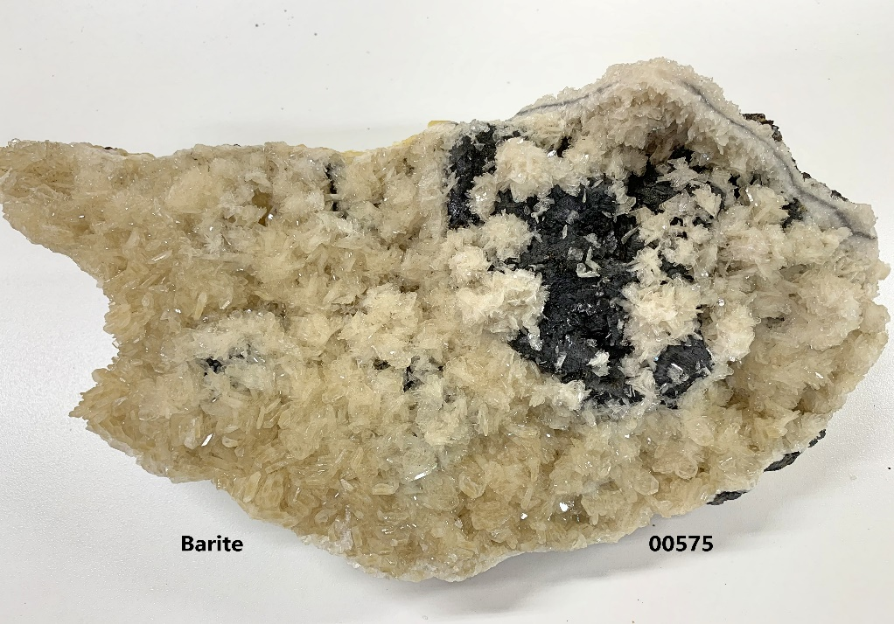
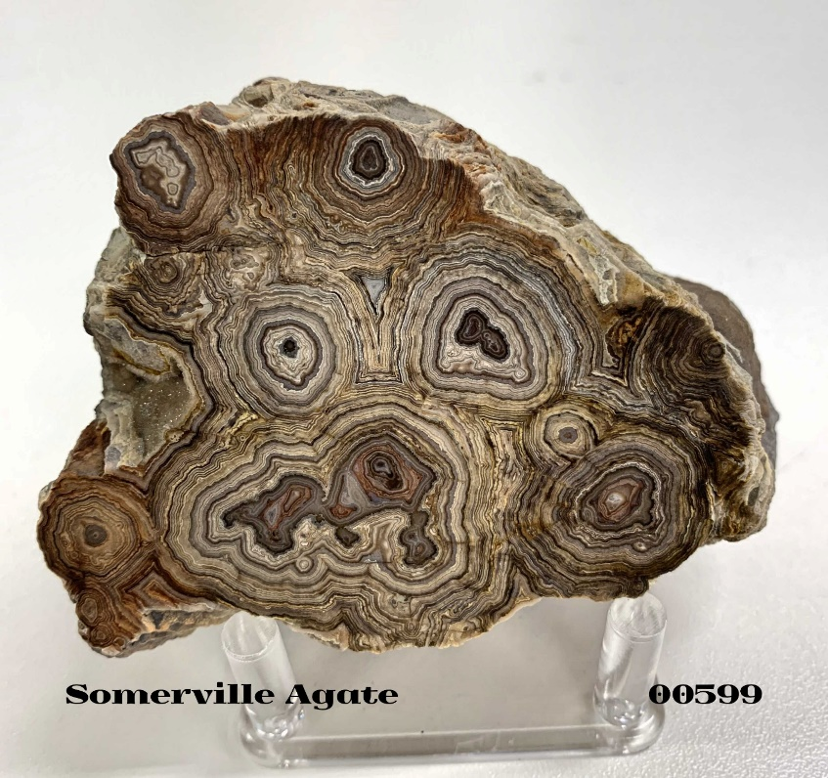
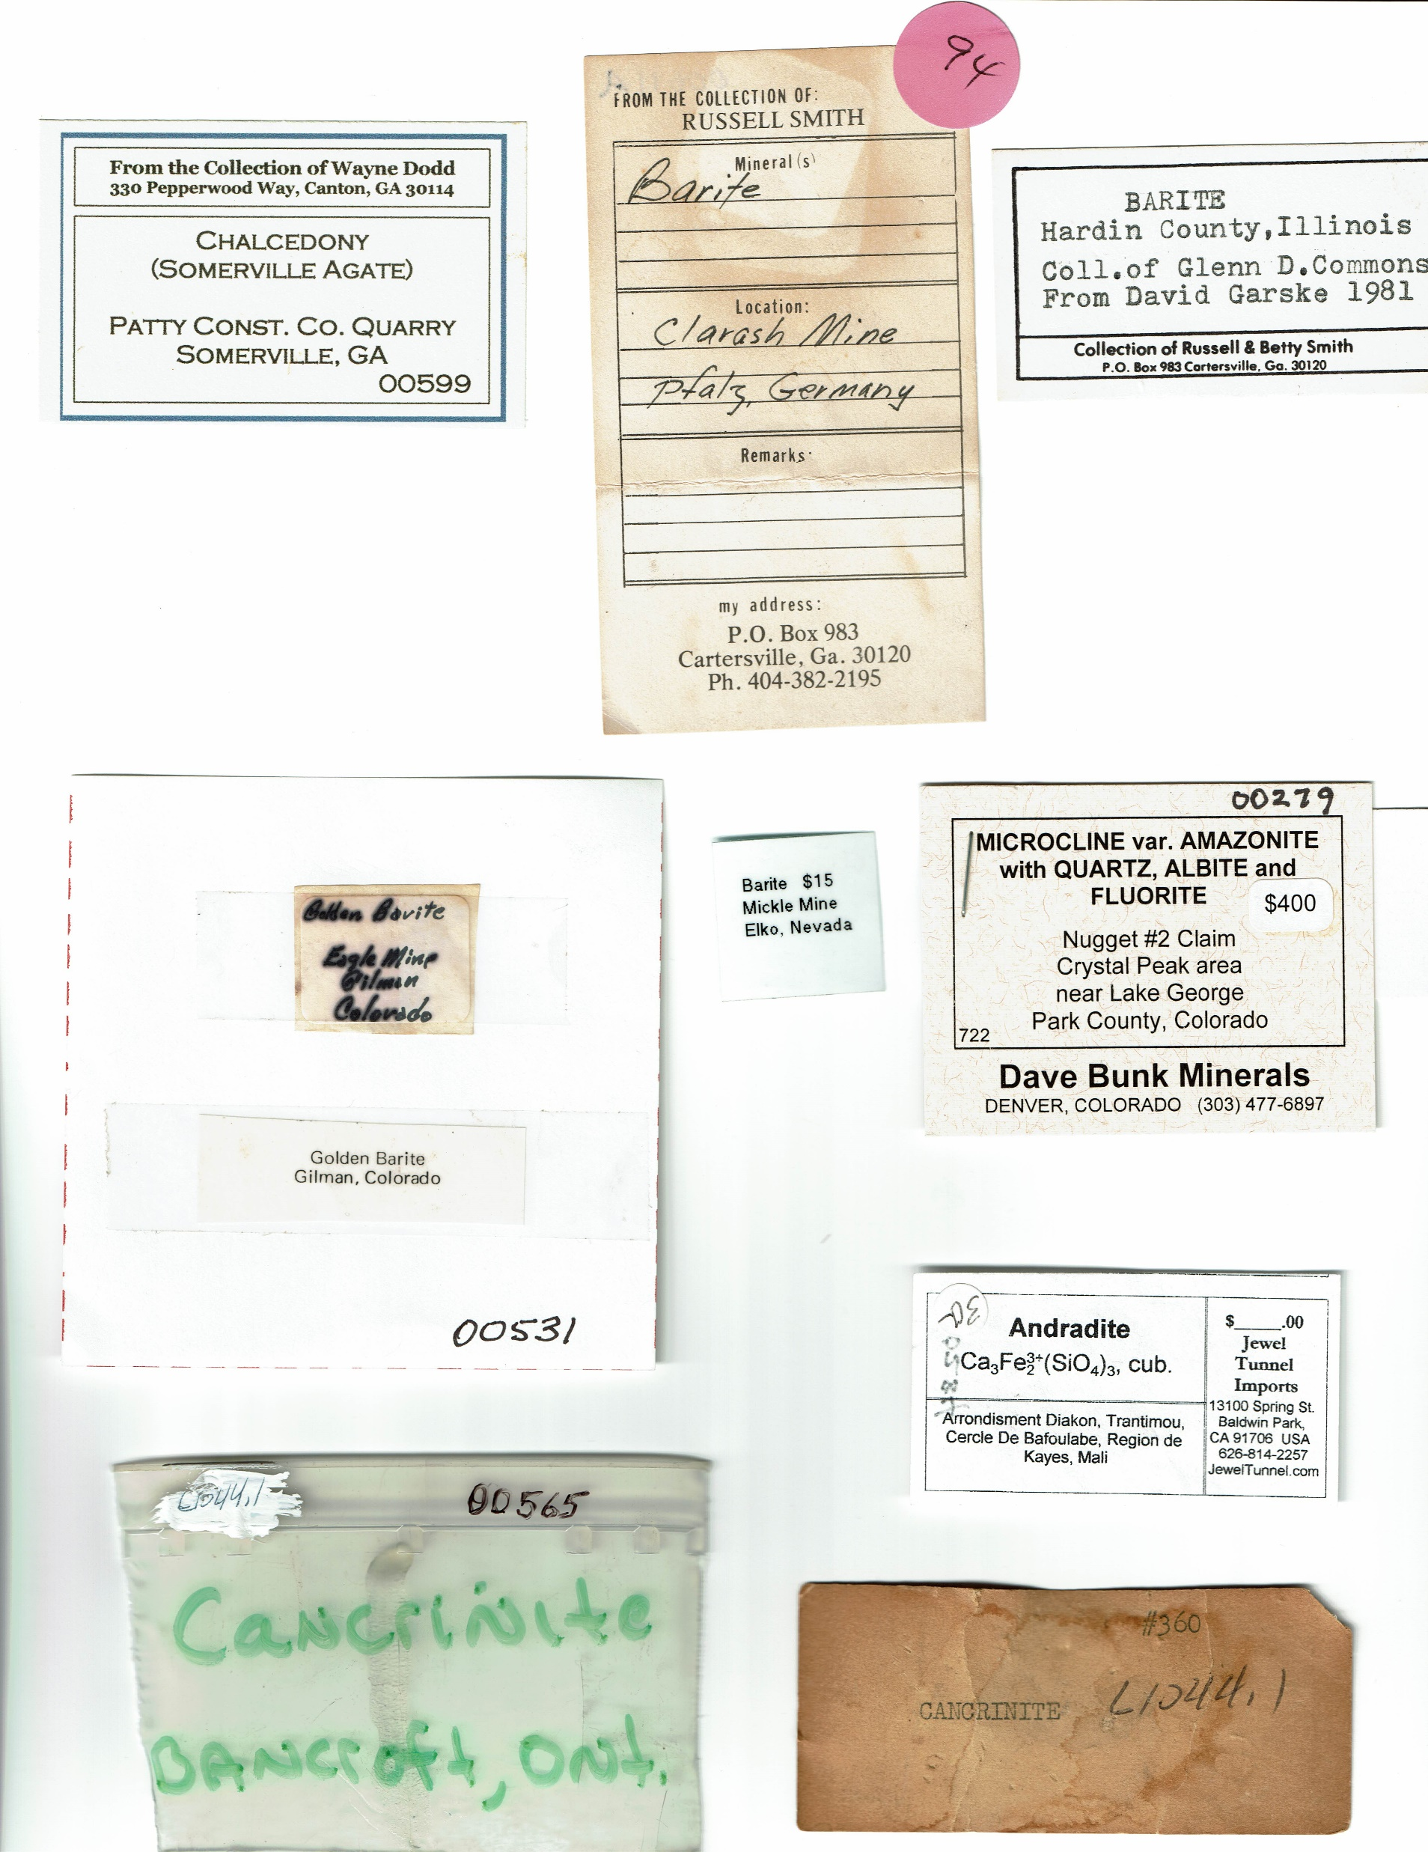
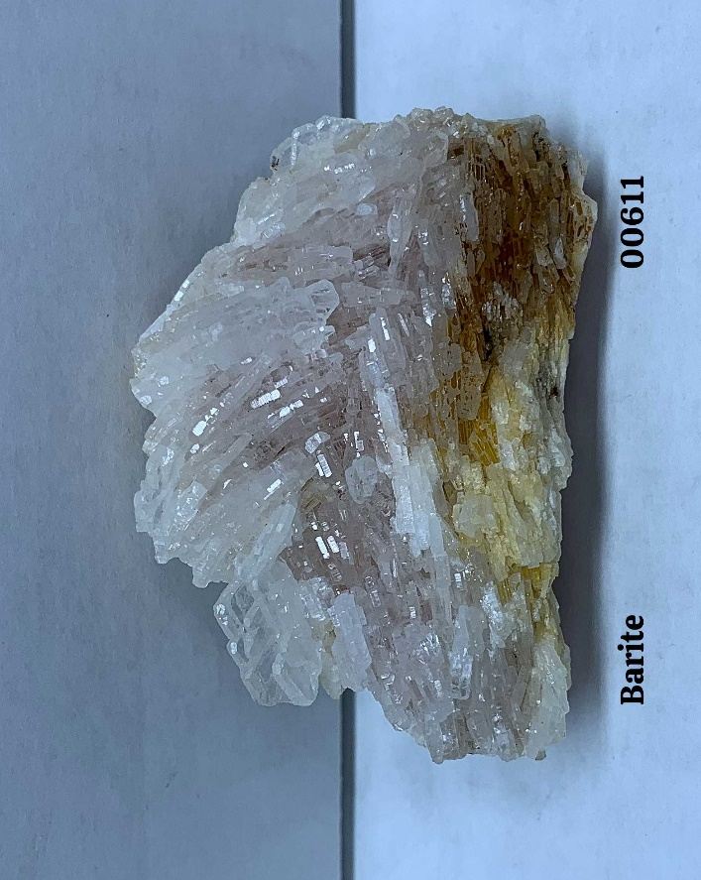
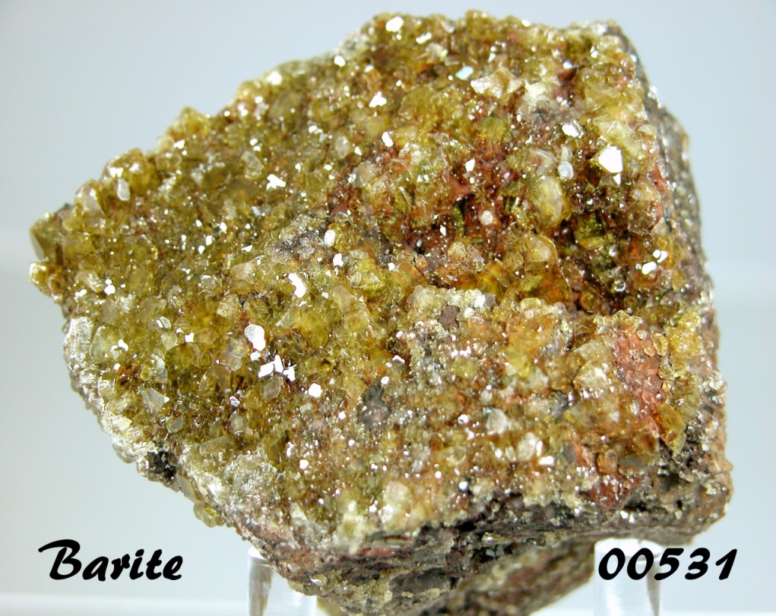
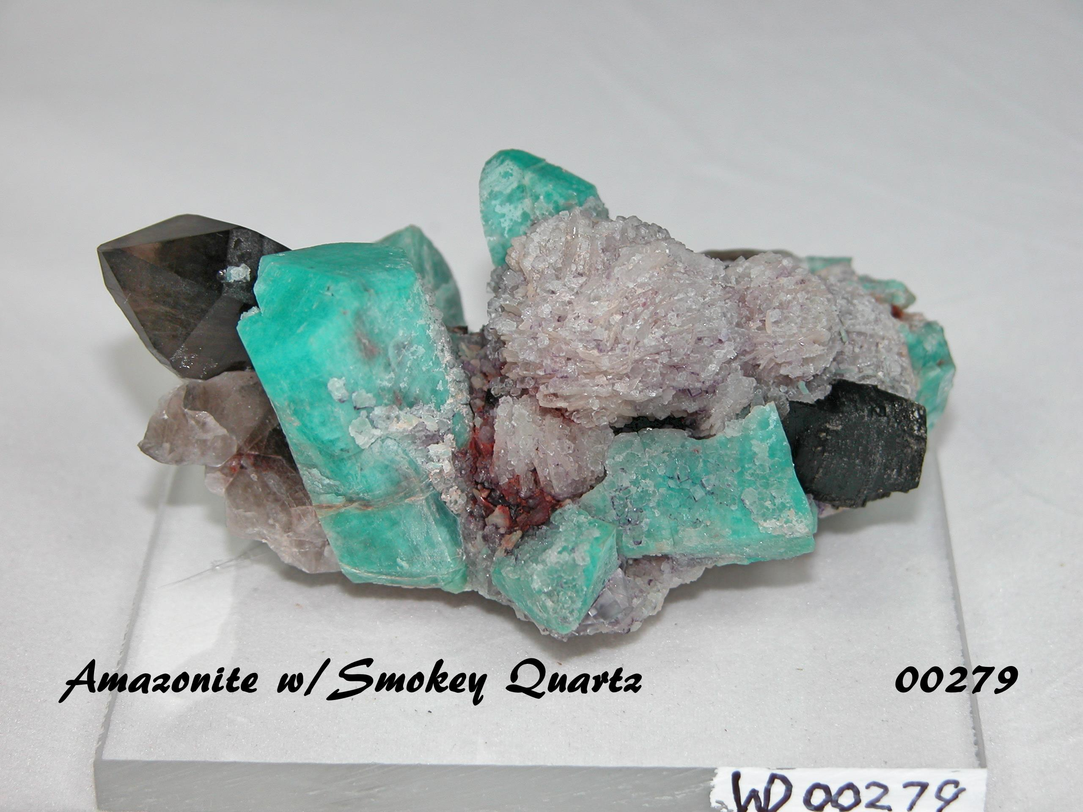
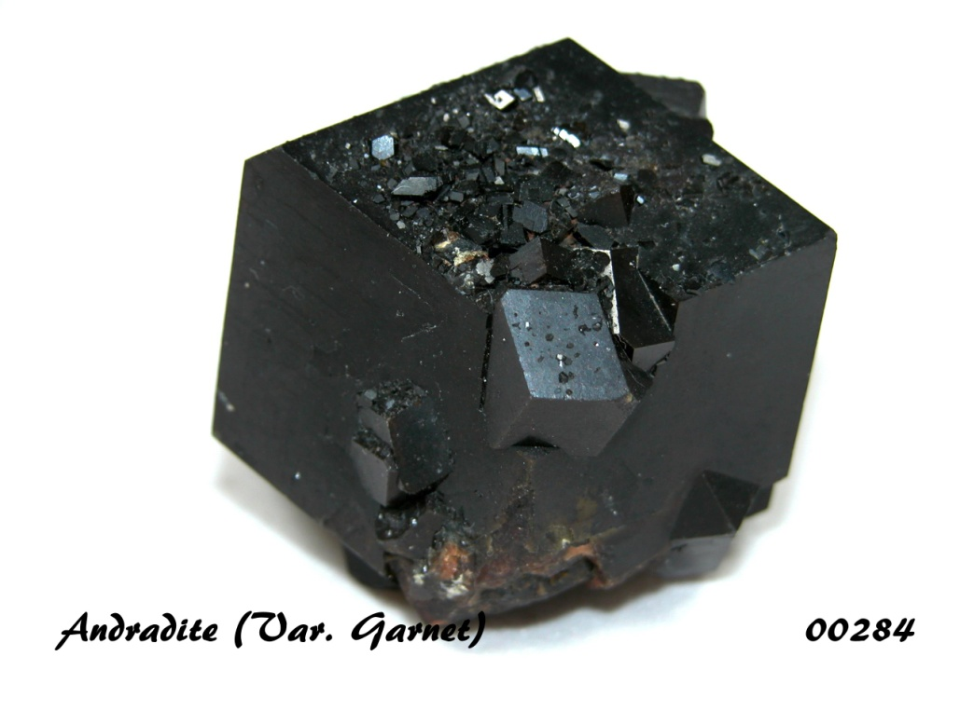
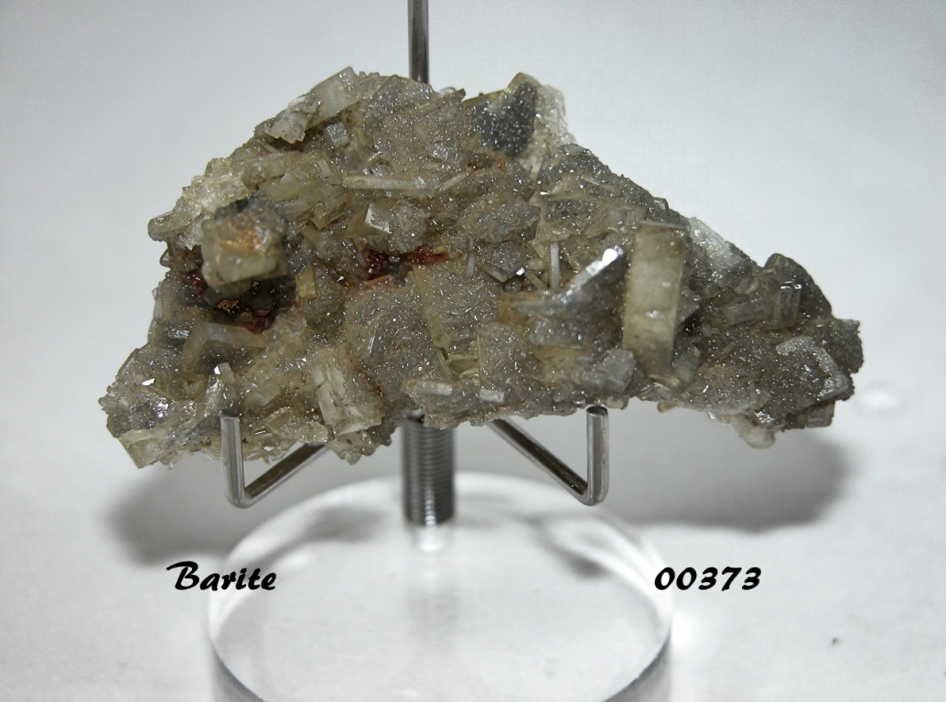
Provenance Examples

Slide 8
Identification
Hopefully you have Provenance Docs. that provide this info.
If so, you might want to go to the internet to verify it and learn more
Key sites:
https://www.mindat.org/
https://www.minerals.net/
https://geology.com/minerals/
https://geology.com/rocks/
Of course, if you don’t have any docs, you can use these site to help figure out what you have.
Key sites:
https://minerals-identify.com/
http://webmineral.com/

Slide 9
Valuation: Very Difficult!
If you have no idea of its value:
The internet is the place to go, but you may find it frustrating.
Try typing in the mineral name followed by /for sale. This may bring up sales sites.
You can assume that any pricing found this way will be Retail. In reality, your rocks are not worth Retail.
Once you have decided on a value, document it in your catalog
If you buy a specimen, be sure to capture the cost in your catalog
If you do, it might be worth checking the internet to see if you got a deal or not
Rocks can be found for sale on eBay, Etsy, etc.. Be wary.
If buying from the internet, be very careful.

Slide 10
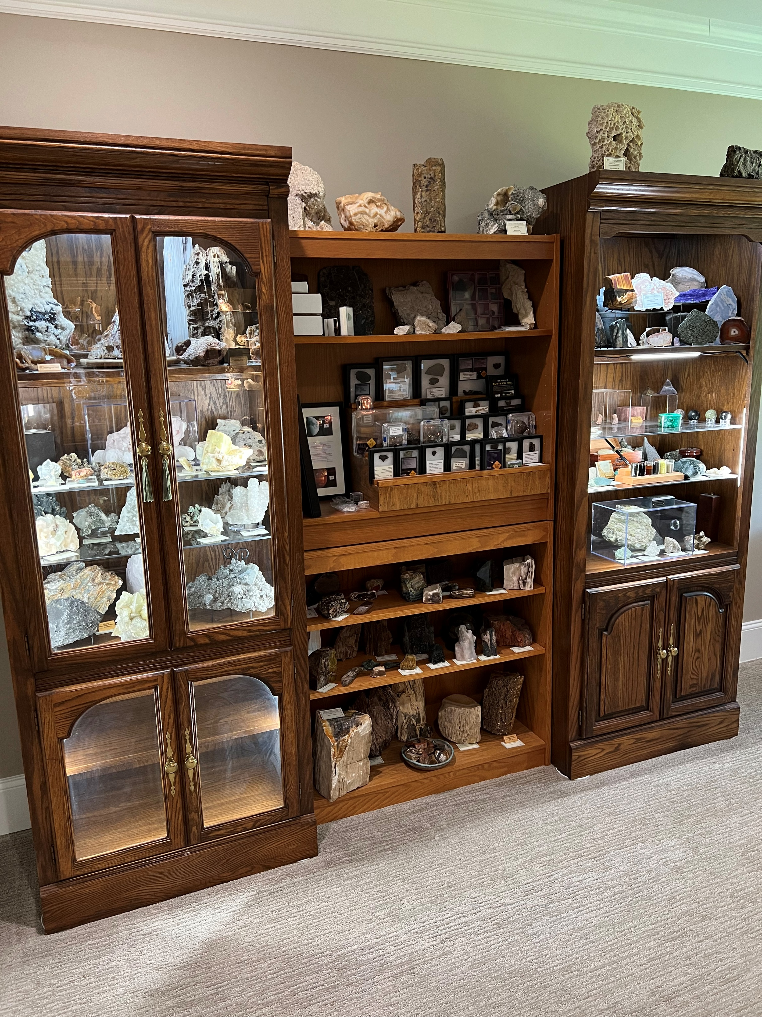
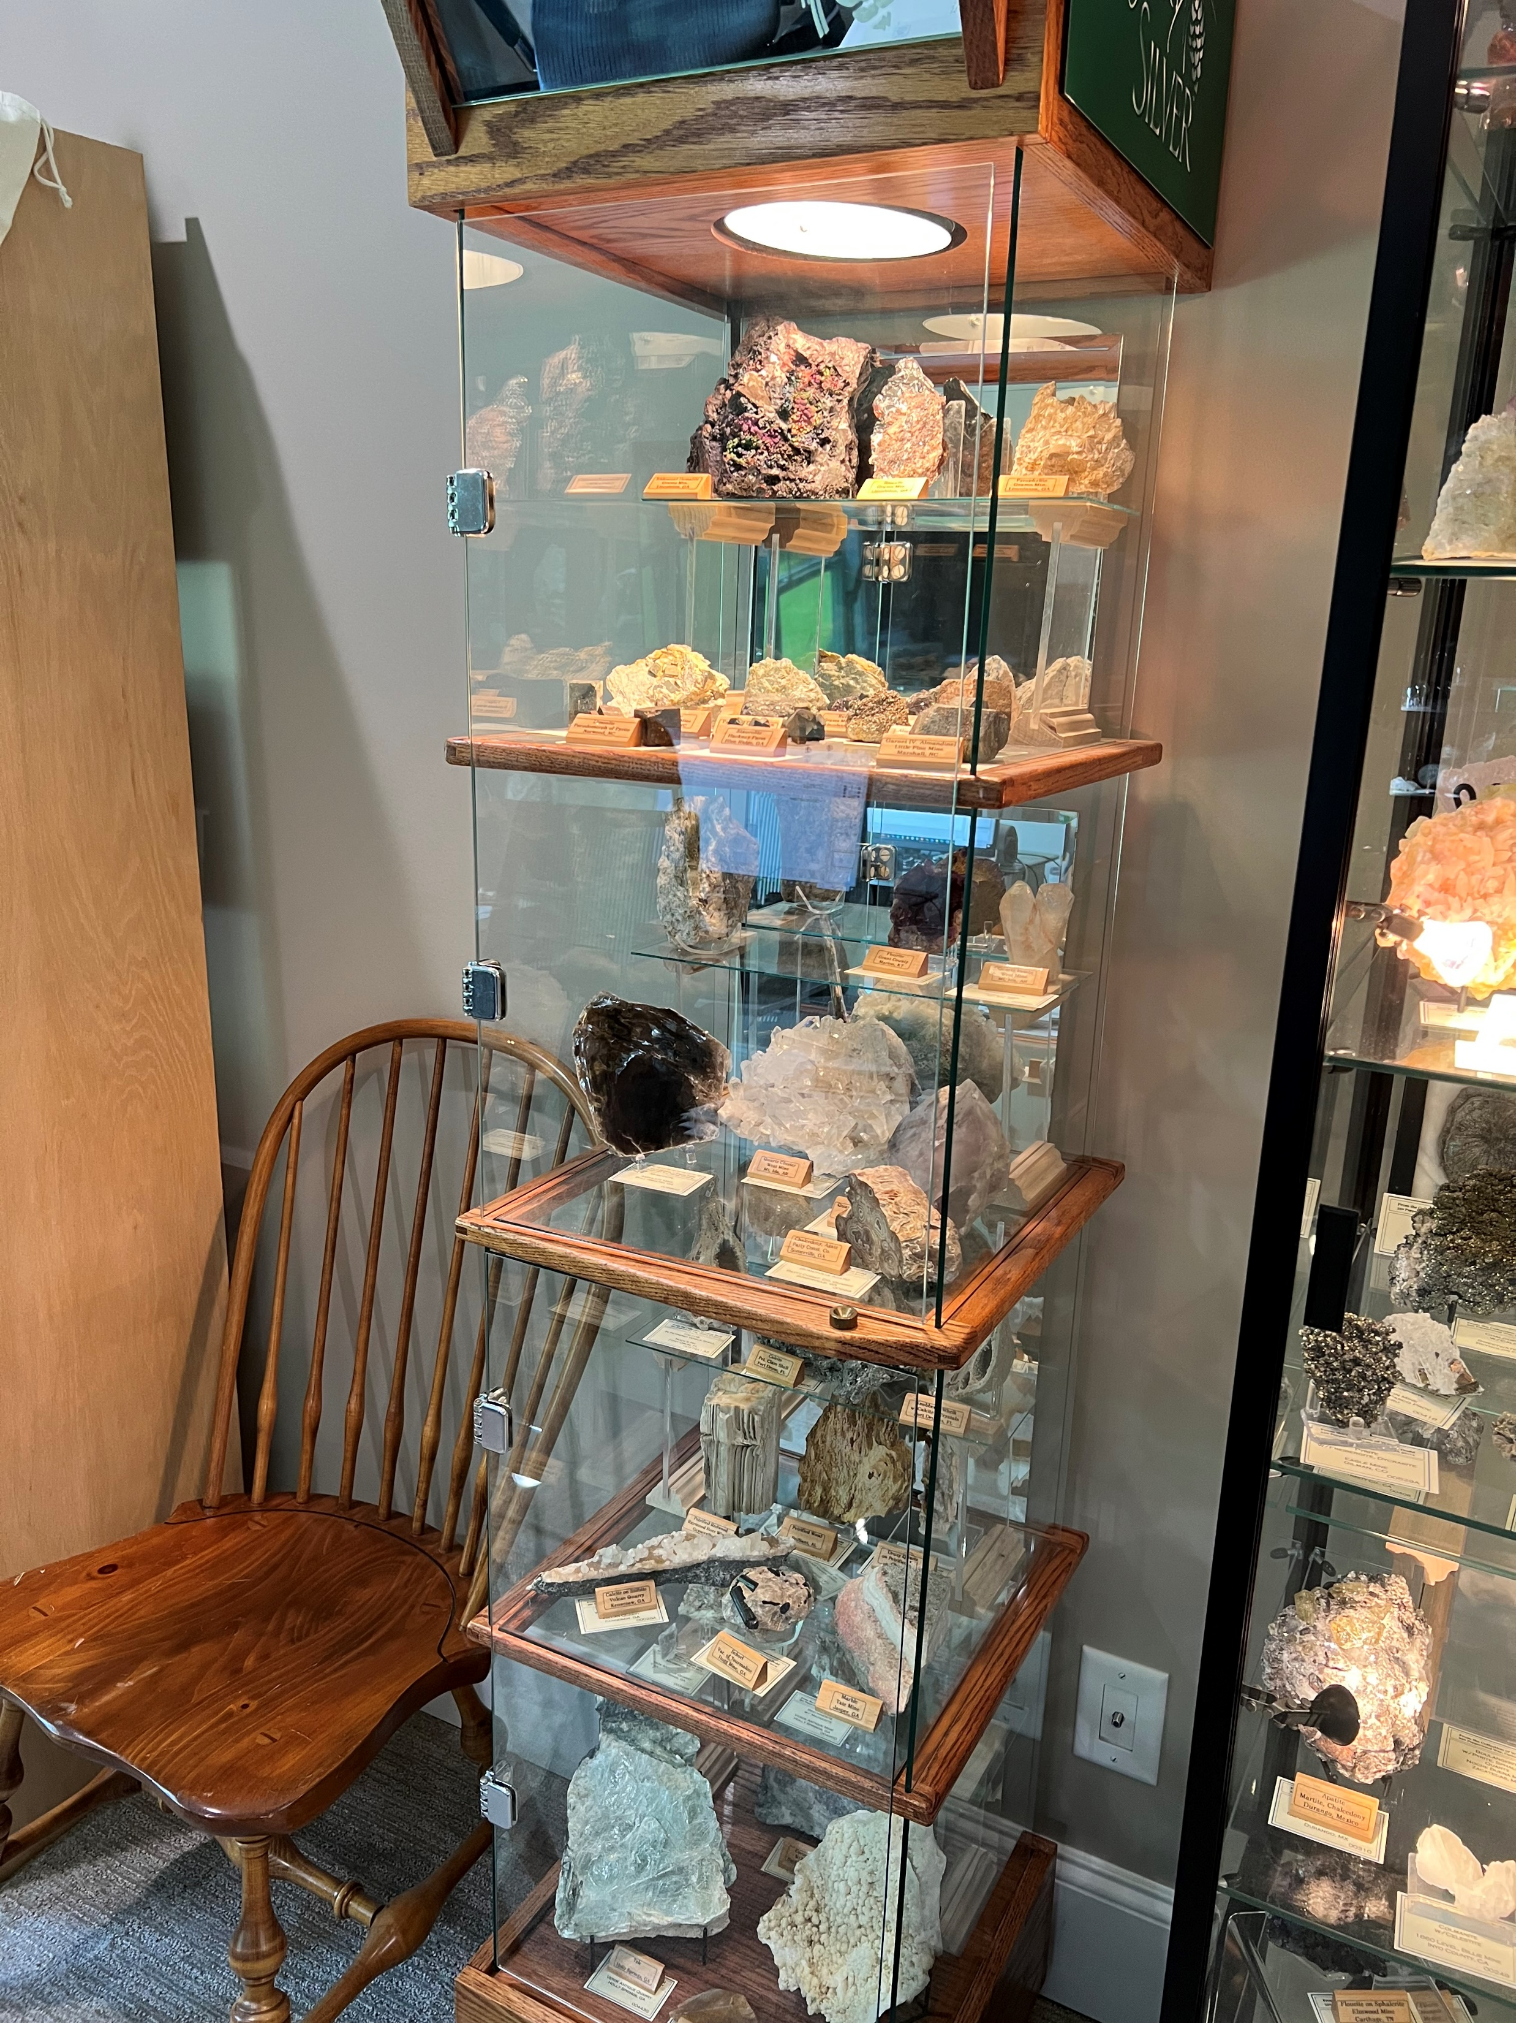
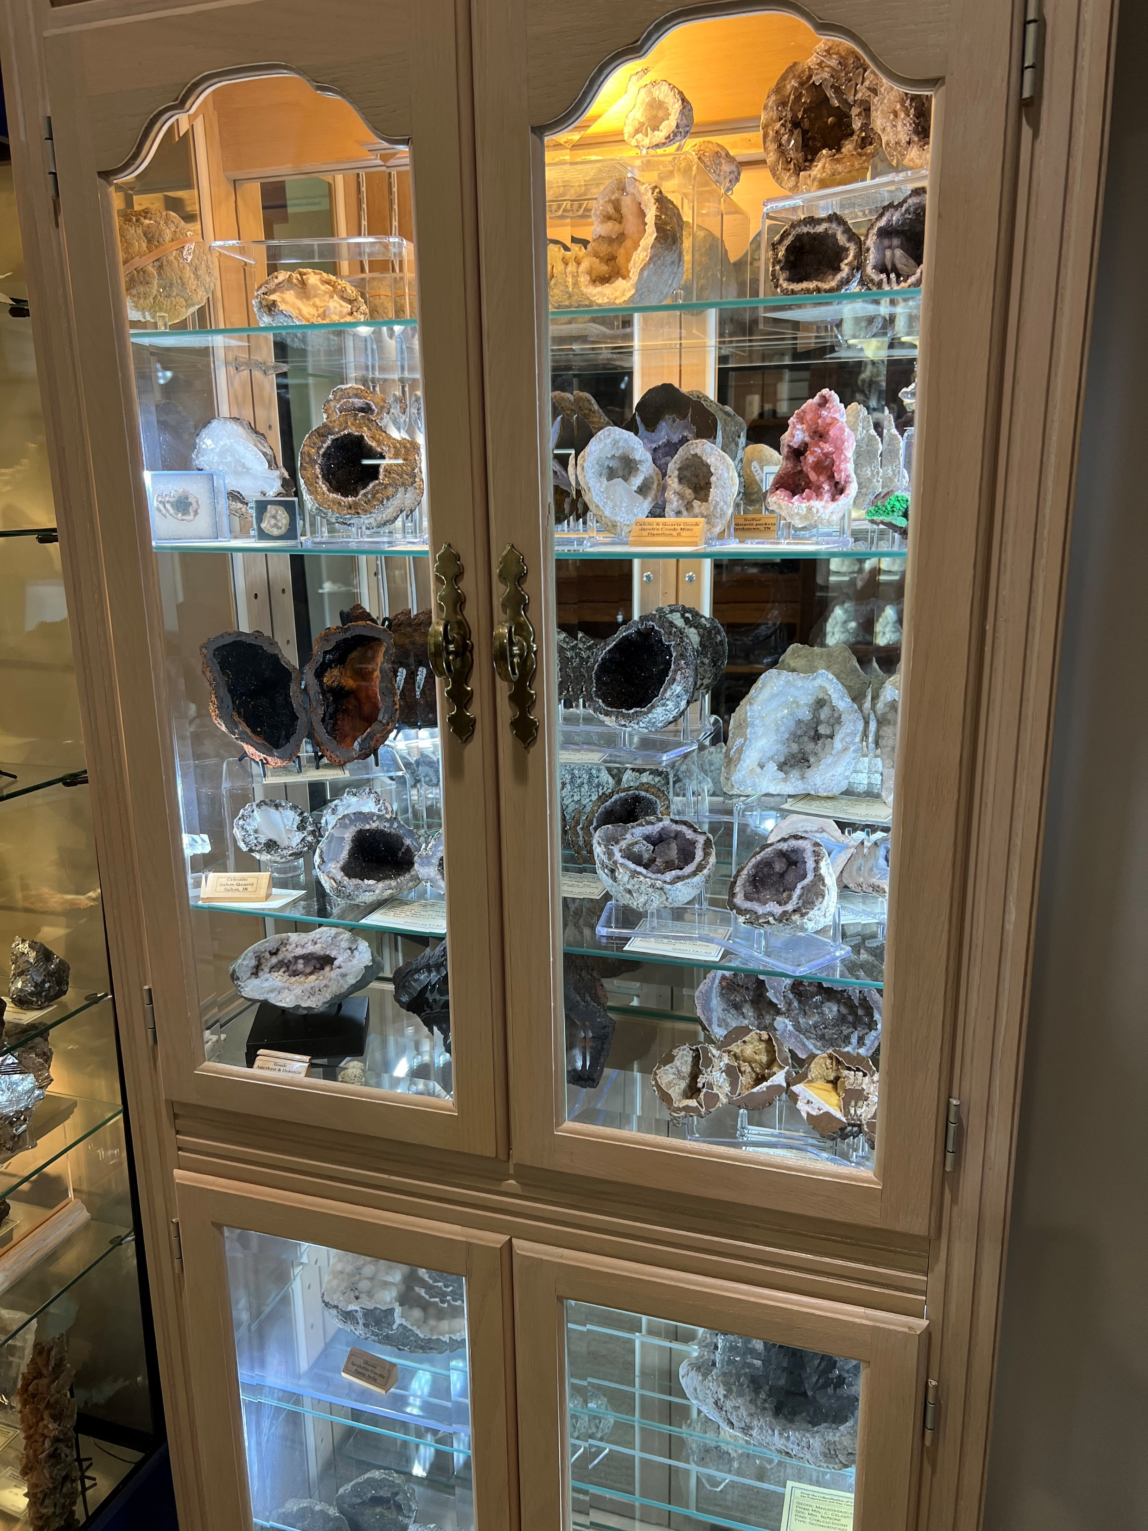
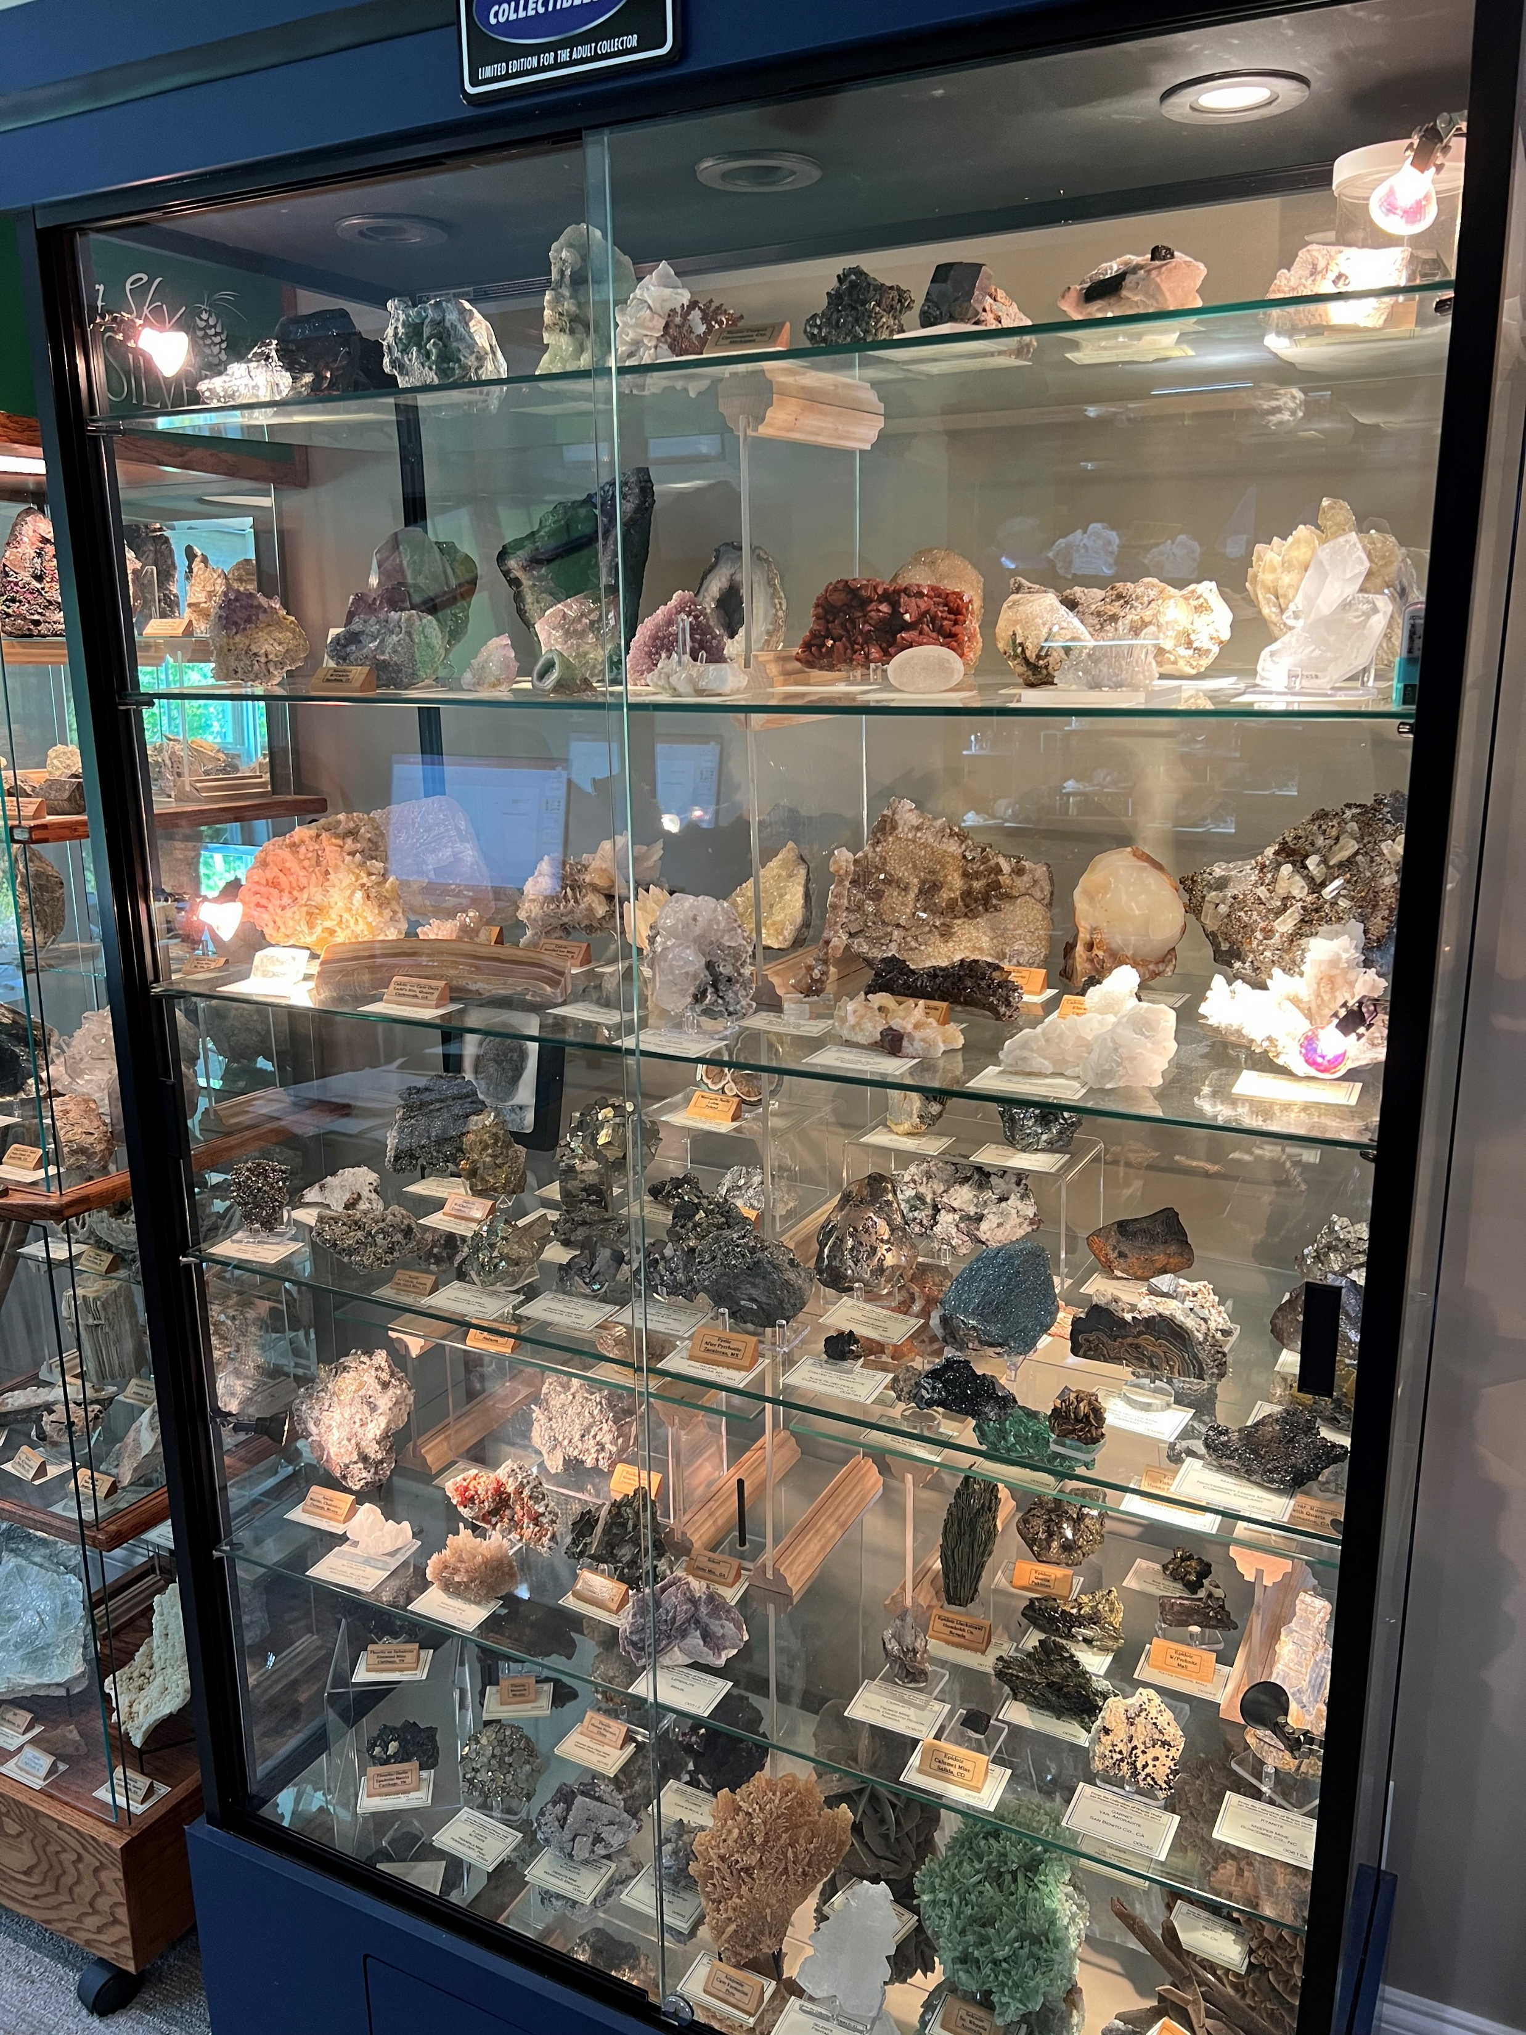
Displaying your rocks
Cabinets that close are best:
Keeps dust off or your pretty rocks
Lots of glass is good
Mirrors in the back are good
Plenty of lighting will make your treasures shine
Where to get them:
Of course, you can go to a furniture store and pay a lot
Look for stores that are closing and see if they have some they will sell
Go to multi-vendor antique shops. Some may be going out of business and would like to sell their cabinets
In Soleil, stay close to the blog.
Goodwill and other thrift shops
Try to avoid direct sunlight. Some minerals will fade or change color from too much sun
Don’t overcrowd your specimens. Do as I say, not as I do!!

Slide 11
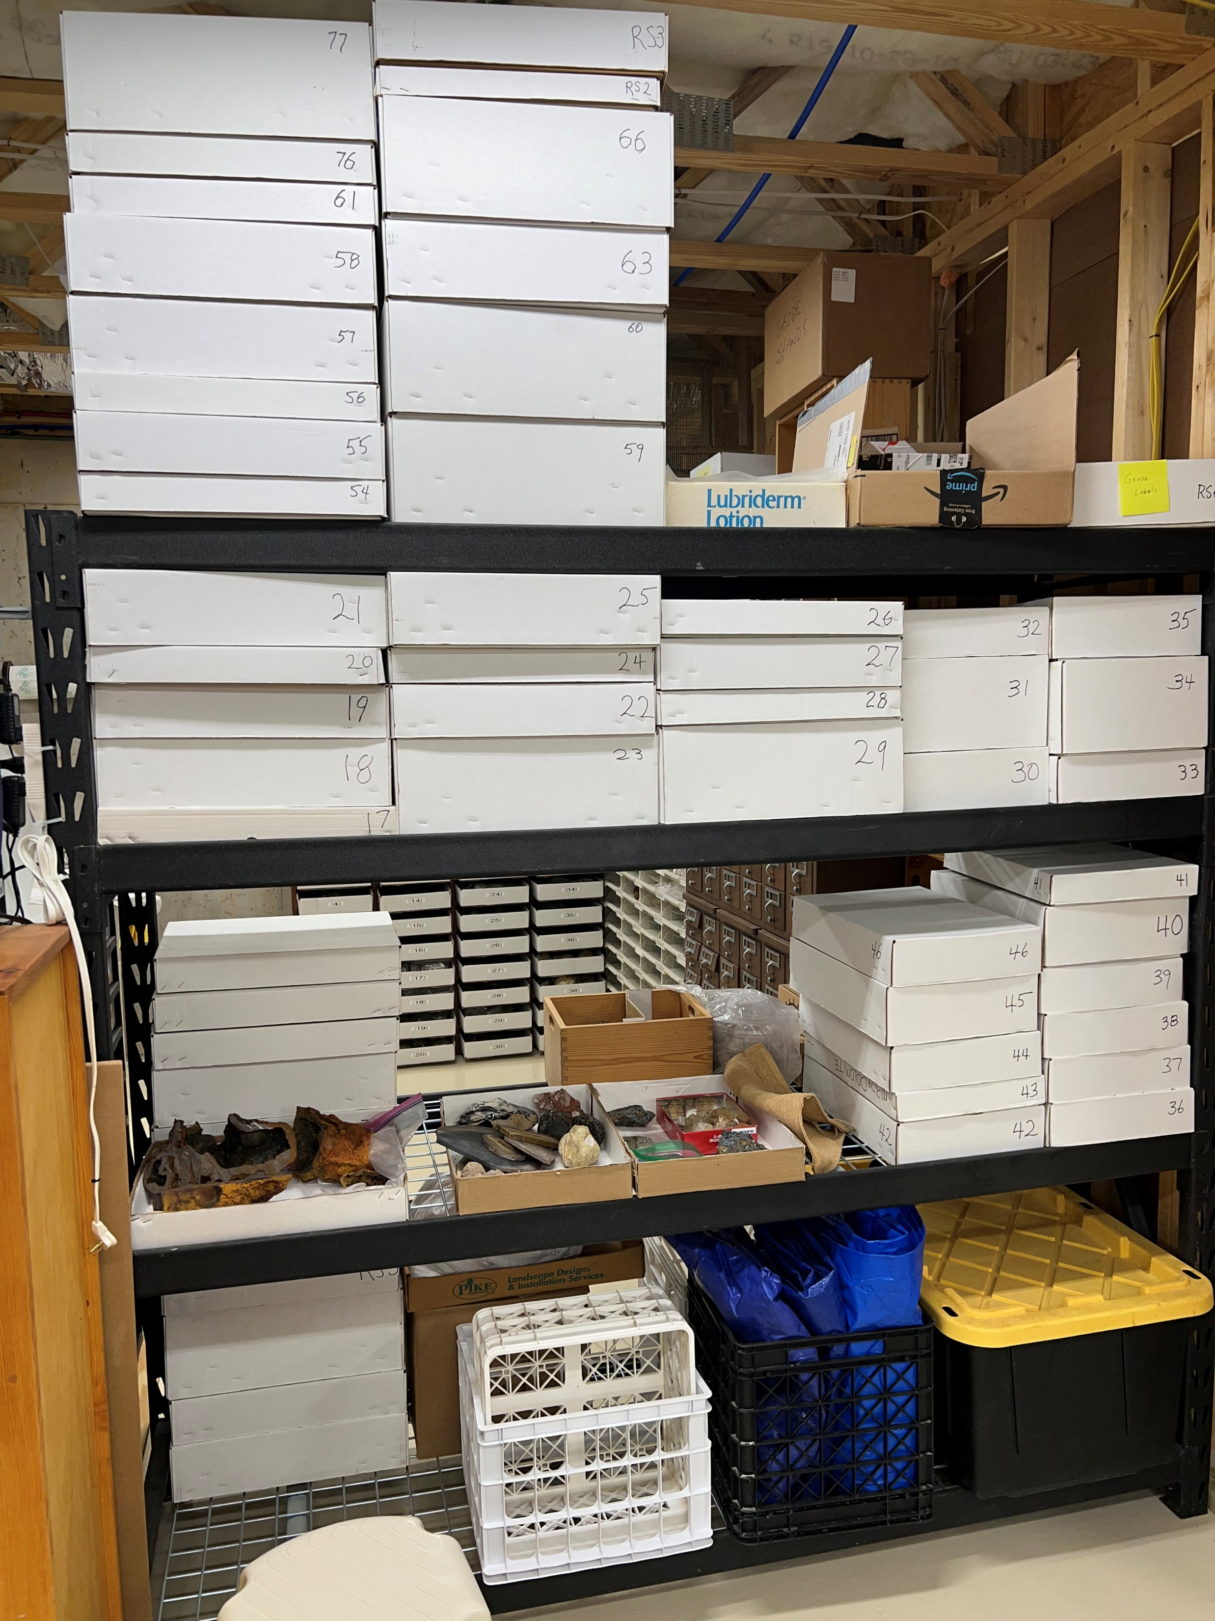
Storage
Storage Flats are perfect for long term storage of specimens you don’t intend to display
https://www.tucsonstorefixtures.com/category_s/1935.htm
General ideas:
Give each flat a unique number
Document each specimen that you store in a box. Keep a list in your catalog
You can store both catalogued and uncatalogued specimens in any box

Slide 12
Photographing Your Rocks
Unless you’re a real photographer, your cell phone will work fine.
Try to set up a white base and background
Watch the lighting.
Use inexpensive or free photo software
Use one that allows you to put text on the photo. You’ll want to put the catalog number on it.
Fotor

Slide 13
Recommended Minimum Catalog Data
Mineral/rock name
Secondary minerals if any
Catalog number
How acquired. Found, purchased (from whom), Gift, etc..
Note if you have provenance docs or not.
Where is it from: State/Country of Origin, Locale of Origin, Site
Storage/display location
Technical data is optional. It’s readily available on the internet
Pics are always good.

Slide 14
How about your Grandkid’s Collections
Use some of your cataloguing principles
Try to keep the collection with specimens that you have identified. As opposed to ugly rocks that your g’kid happened to like.
This is not to say, don’t bring home ugly rocks. If the kid likes them that’s all that matters
Provide a little information on the specimen
Document where it came from

Slide 15
Storage Container Suggestions
Ideally these should have movable dividers
Select units according to the size of your specimens
Create a document that minimizes the chance of mixing up the specimens

Slide 16
Labeling for a Kid’s case
Ethan's Rocks
Obsidian Volcanic Glass (Commonly called an Apache Tear) Polished | Petrified wood: Polished Oregon | Petrified wood: Polished Sweetwater, TX | Agate Polished | Barite Paga Mine, Cartersville, GA | Goethite Webster County, GA
Quartz Crystal Mt. Ida, Arkansas | Pyrite Standard Mine, Glendon, NC Sometimes known as "fools gold" because miners mistook it for the real thing | Garnet (Almondine) Epworth, GA | Lazulite in Quartzite matrix Graves Mtn., Lincolnton, GA (The blue Parts of the rock) There are also tiny Pyrite crystals in the rock | Ilmenite, Graves Mountain Quarry, Lincolnton, GA | Rose Quartz, Hogg Mine, LaGrange, GA
Talc, Nantahala Limestone quarry, Andrews, NC (The softest mineral. You can scratch it with your fingernail.) | Talc, Verde Antique Quarry, Woodstock, GA | Kyanite Graves Mtn. Lincolnton, GA | Limonite after Pyrite Norwood, NC | Garnet (Almondine) Little Pine Garnet Mine, Marshall, NC | Staurolite Young Farm Brasstown, NC The State Mineral of GA
 |  |  | Geode w/Quartz Crystals Jacob's Mine, Hamilton, IL
Hinge side, upper left

Slide 17
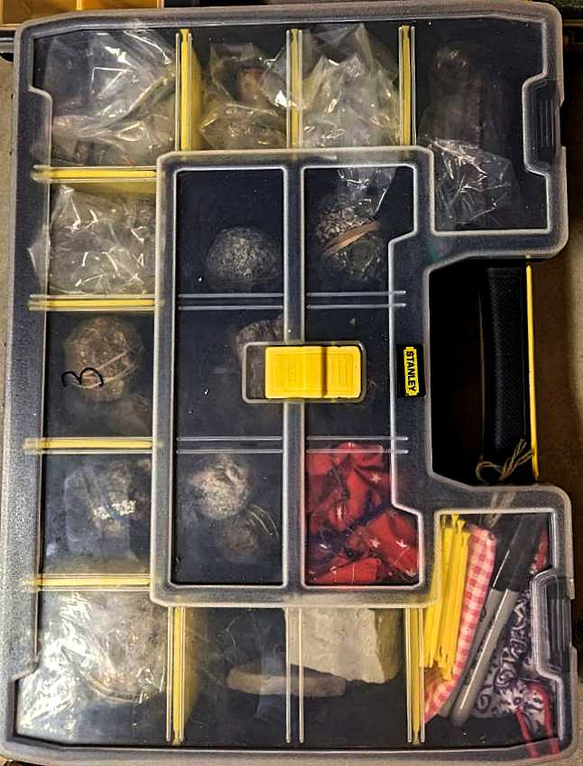
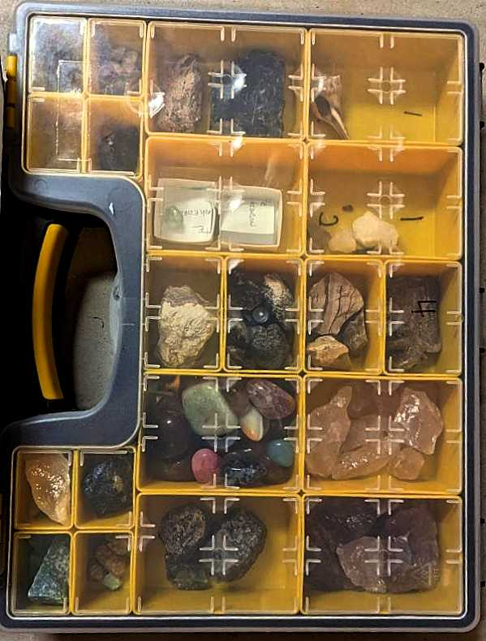
My Grandson Everett’s Storage Cases

